Slide 1
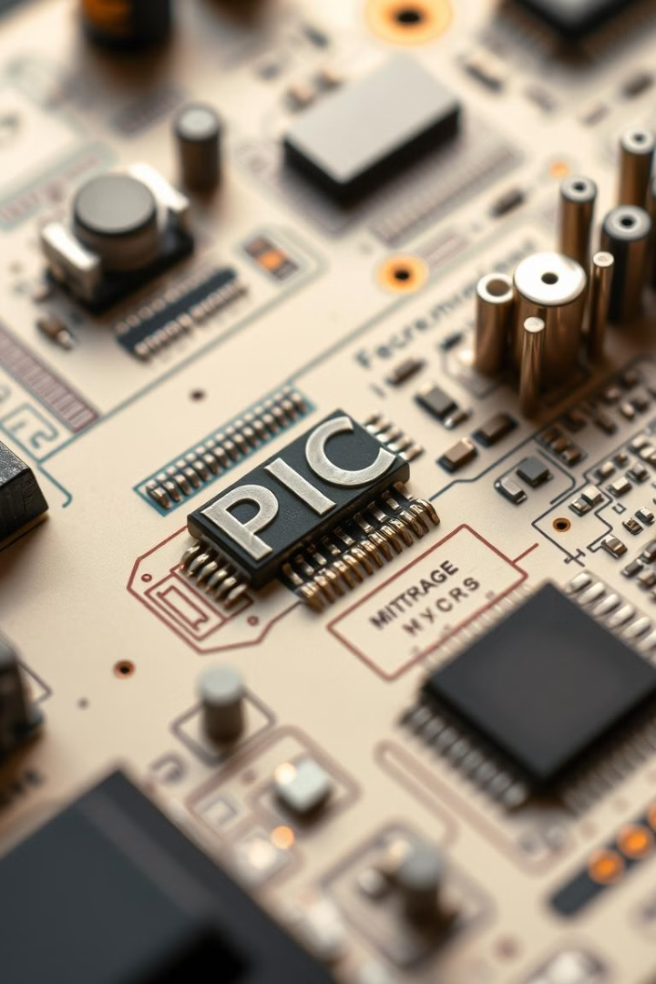

Using PWM and ADC Features in PIC Microcontrollers for Real-World Projects
Discover the power of PIC microcontrollers and how their Pulse Width Modulation (PWM) and Analog-to-Digital Conversion (ADC) features can be leveraged to create innovative real-world projects. Explore the fundamentals and dive into practical applications that bring your ideas to life.

Slide 2
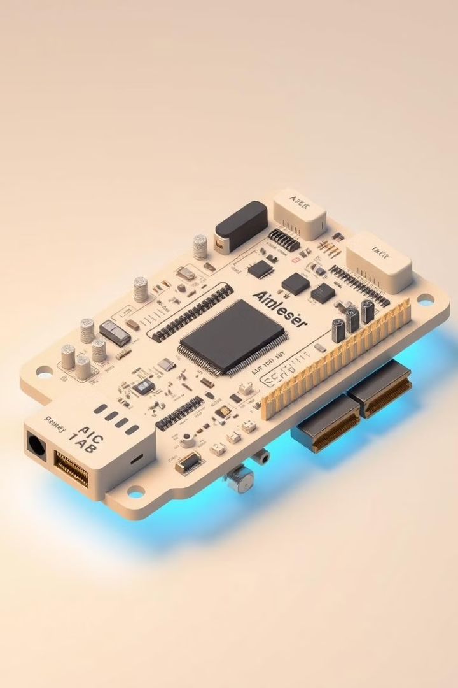
Introduction to PIC Microcontrollers
1
Versatile Platforms
2
Ease of Use
PIC microcontrollers offer a wide range of features and capabilities, making them suitable for a diverse array of applications.
PIC MCUs are known for their user-friendly development tools and robust ecosystem, simplifying the prototyping and implementation process.
3
Growing Popularity
PIC microcontrollers are widely used in industries, ranging from automotive to home automation, due to their reliability and performance.

Slide 3




Understanding Pulse Width Modulation (PWM)
Motor Control
LED Dimming
Power Regulation
PWM enables precise control of motor speed and torque by varying the duty cycle.
PWM can be used to control the brightness of LEDs by modulating the duty cycle.
PWM-based power supplies and converters optimize energy efficiency and control power delivery.

Slide 4
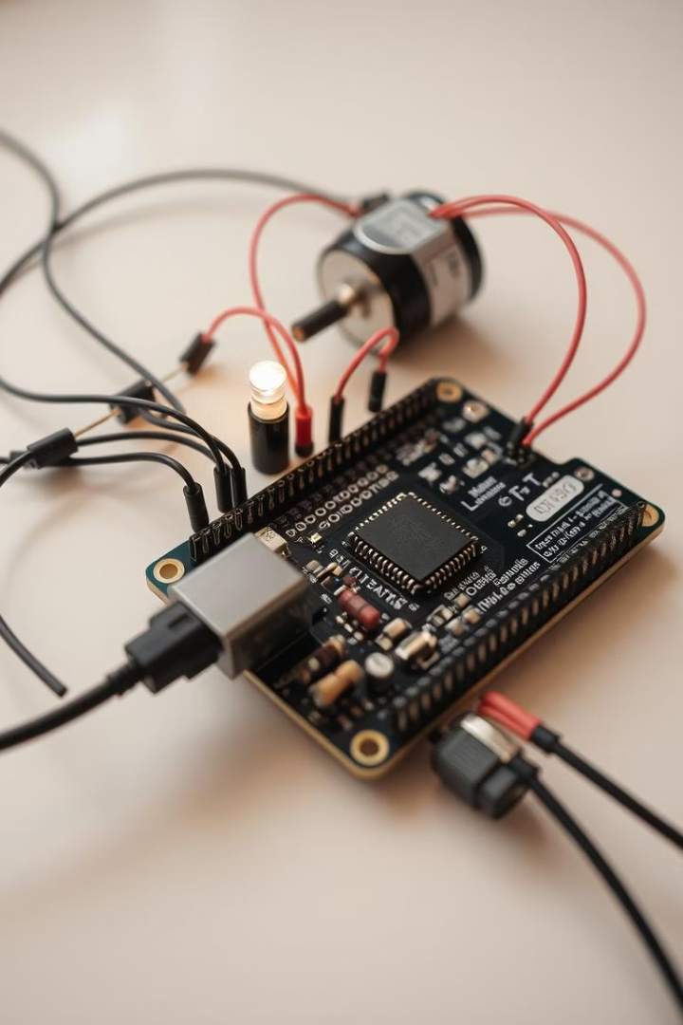
Implementing PWM for Motor Control and LED Dimming
1
PWM Generation
Utilize the built-in PWM modules in PIC MCUs to generate the desired waveforms.
2
Motor Driver Interface
Connect the PWM output to a motor driver circuit to control motor speed and direction.
3
LED Dimming Control
Adjust the PWM duty cycle to smoothly control the brightness of LED lights.

Slide 5
Analog-to-Digital Conversion (ADC) Essentials
Sensor Interfacing
Measurement and Monitoring
Signal Conditioning
Use the ADC feature to convert analog sensor signals into digital data that can be processed by the microcontroller.
Accurately measure and monitor various physical quantities, such as temperature, pressure, or light intensity, using the ADC.
Leverage the ADC to condition and process analog signals, enabling more precise control and decision-making.

Slide 6
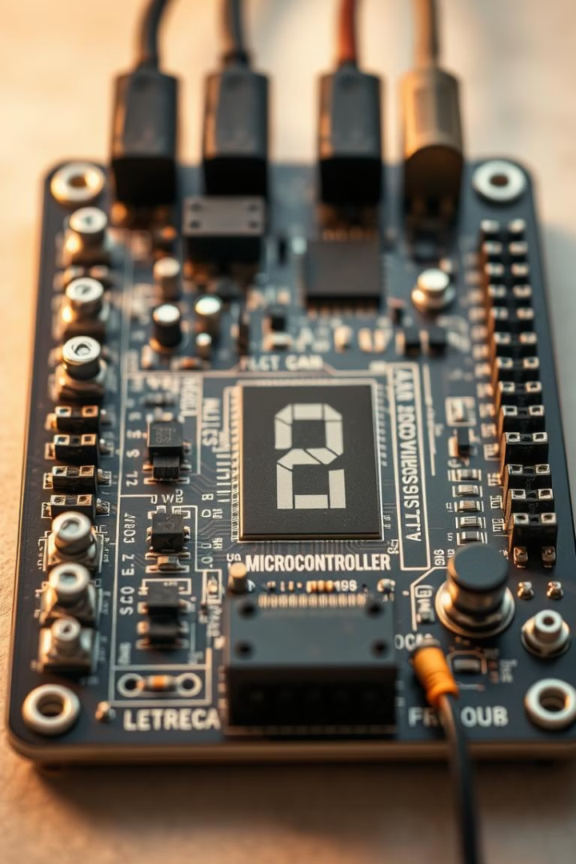
Leveraging ADC for Sensor Interfacing
Temperature Sensing
Light Intensity Measurement
Connect a thermistor or temperature sensor to the ADC input to monitor and control temperature in your projects.
Use a photoresistor or photodiode with the ADC to detect and react to changes in ambient light levels.
Pressure Monitoring
Position and Motion Tracking
Interface a pressure sensor with the ADC to measure and monitor fluid or gas pressure in your system.
Connect potentiometers or position sensors to the ADC to track the movement and position of mechanical components.

Slide 7
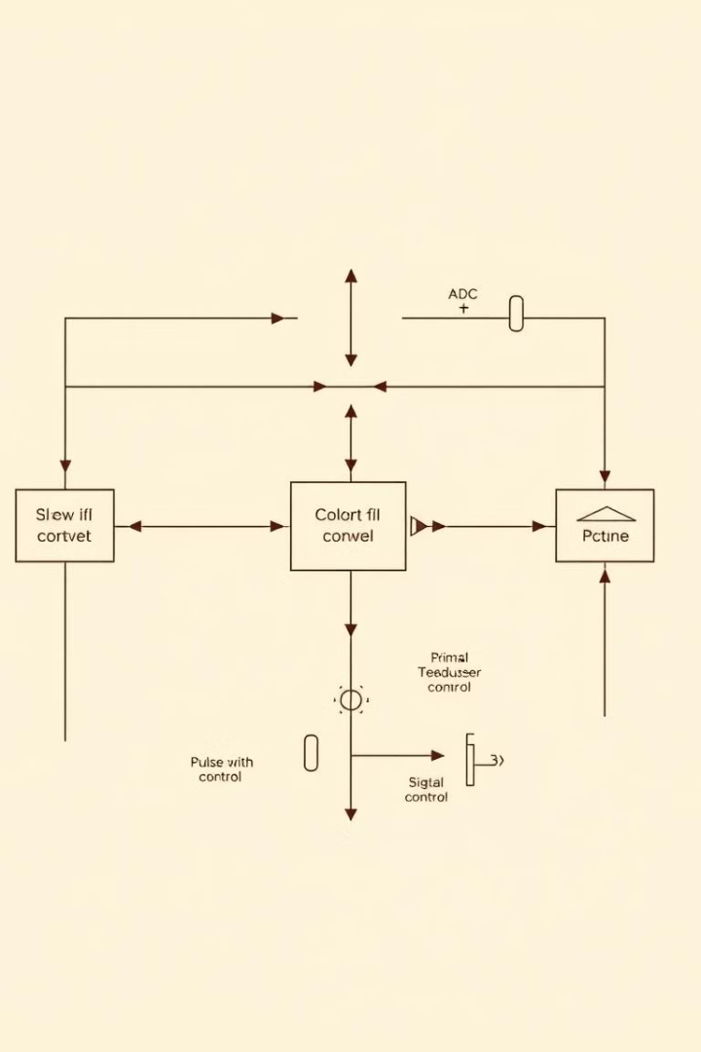



Combining PWM and ADC for Closed-Loop Control
Sensor Input
The ADC converts analog sensor data into digital values for the microcontroller to process.
Control Algorithm
The microcontroller applies a control algorithm to the sensor data and generates a PWM output signal.
Actuation
The PWM signal is used to control the actuation of a motor, servo, or other device to achieve the desired behavior.

Slide 8
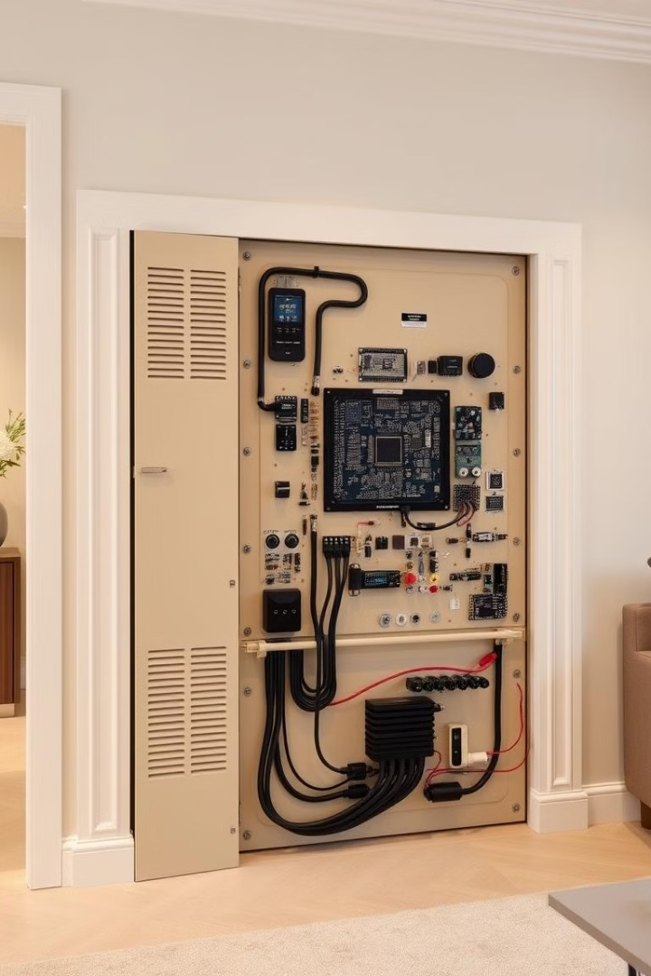
Real-World Project Examples and Demonstrations
1
Smart Home Automation
2
Industrial Control Systems
Utilize PWM and ADC to create intelligent lighting systems, temperature controllers, and energy-efficient appliances.
Implement closed-loop control for industrial processes, such as motor speed regulation and machine monitoring.
3
Robotics and Mechatronics
Integrate PWM and ADC for precise motion control, sensor feedback, and autonomous decision-making in robotic systems.

Slide 9


